Slide 1
Security
Chapter 9
Tanenbaum & Bos, Modern Operating Systems: 4th ed., Global Edition (c) 2015 Pearson Education Limited. All rights reserved.

Slide 2
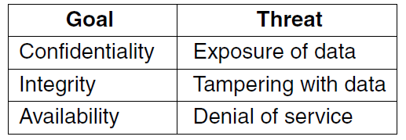
The Security Environment
Threats
Figure 9-1. Security goals and threats.
Tanenbaum & Bos, Modern Operating Systems: 4th ed., Global Edition (c) 2015 Pearson Education Limited. All rights reserved.

Slide 3
Can We Build Secure Systems?
Two questions concerning security:
Is it possible to build a secure computer system?
If so, why is it not done?
Tanenbaum & Bos, Modern Operating Systems: 4th ed., Global Edition (c) 2015 Pearson Education Limited. All rights reserved.

Slide 4
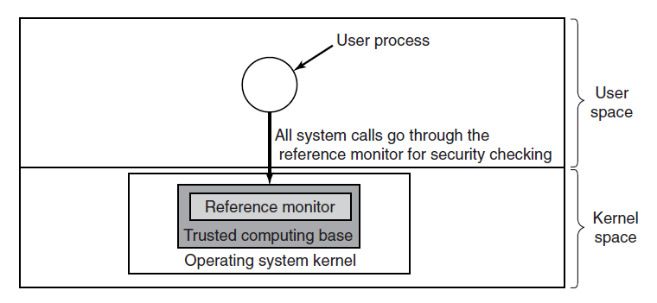
Trusted Computing Base
Figure 9-2. A reference monitor.
Tanenbaum & Bos, Modern Operating Systems: 4th ed., Global Edition (c) 2015 Pearson Education Limited. All rights reserved.

Slide 5
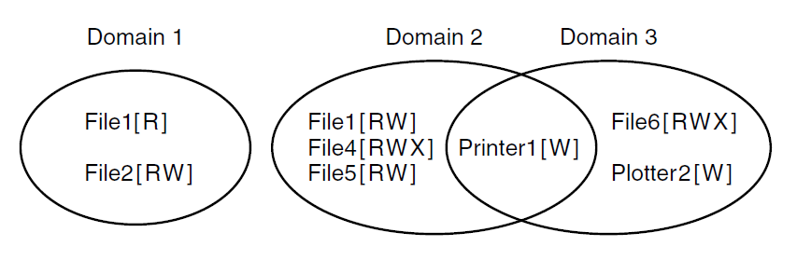
Protection Domains (1)
Figure 9-3. Three protection domains.
Tanenbaum & Bos, Modern Operating Systems: 4th ed., Global Edition (c) 2015 Pearson Education Limited. All rights reserved.

Slide 6
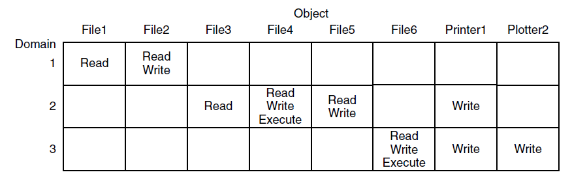
Protection Domains (2)
Figure 9-4. A protection matrix.
Tanenbaum & Bos, Modern Operating Systems: 4th ed., Global Edition (c) 2015 Pearson Education Limited. All rights reserved.

Slide 7
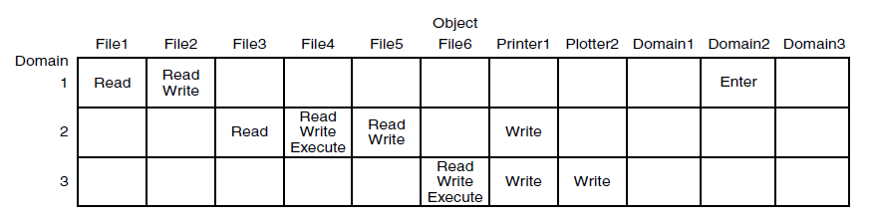
Protection Domains (3)
Figure 9-5. A protection matrix with domains as objects.
Tanenbaum & Bos, Modern Operating Systems: 4th ed., Global Edition (c) 2015 Pearson Education Limited. All rights reserved.

Slide 8
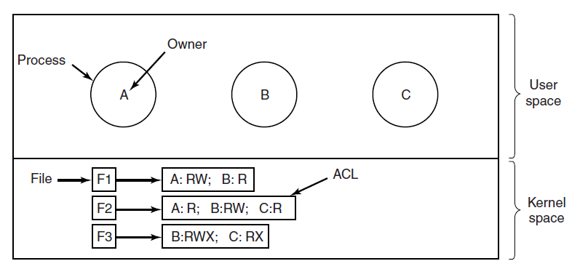
Access Control Lists (1)
Figure 9-6. Use of access control lists to manage file access.
Tanenbaum & Bos, Modern Operating Systems: 4th ed., Global Edition (c) 2015 Pearson Education Limited. All rights reserved.

Slide 9
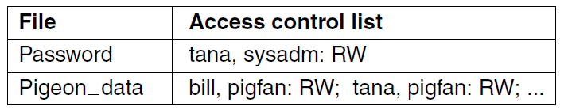
Access Control Lists (2)
Figure 9-7. Two access control lists.
Tanenbaum & Bos, Modern Operating Systems: 4th ed., Global Edition (c) 2015 Pearson Education Limited. All rights reserved.

Slide 10
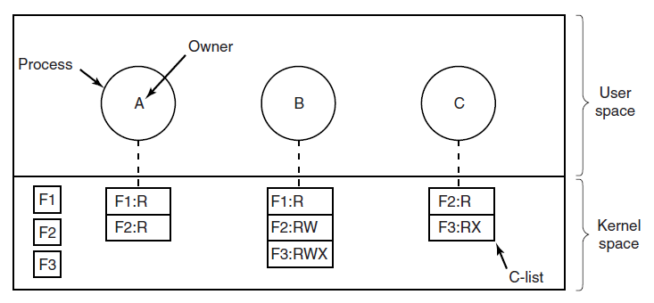
Capabilities (1)
Figure 9-8. When capabilities are used, each
process has a capability list.
Tanenbaum & Bos, Modern Operating Systems: 4th ed., Global Edition (c) 2015 Pearson Education Limited. All rights reserved.

Slide 11

Capabilities (2)
Figure 9-9. A cryptographically protected capability.
Tanenbaum & Bos, Modern Operating Systems: 4th ed., Global Edition (c) 2015 Pearson Education Limited. All rights reserved.

Slide 12
Capabilities (3)
Examples of generic rights:
Copy capability: create new capability for same object.
Copy object: create duplicate object with new capability.
Remove capability: delete entry from C-list; object unaffected.
Destroy object: permanently remove object and capability.
Tanenbaum & Bos, Modern Operating Systems: 4th ed., Global Edition (c) 2015 Pearson Education Limited. All rights reserved.

Slide 13
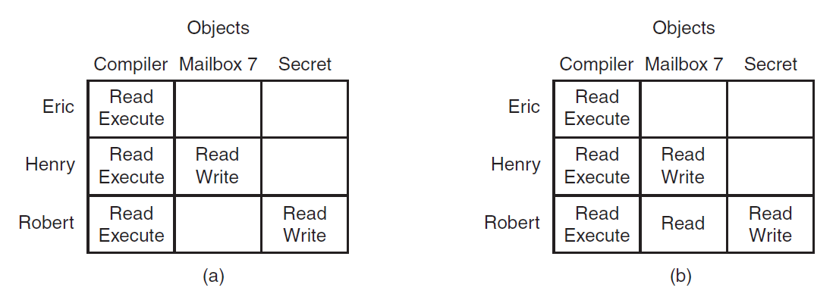
Formal Models of Secure Systems
Figure 9-10. (a) An authorized state.
(b) An unauthorized state.
Tanenbaum & Bos, Modern Operating Systems: 4th ed., Global Edition (c) 2015 Pearson Education Limited. All rights reserved.

Slide 14
Multilevel Security
Bell-LaPadula Model
Bell-LaPadula Model rules for information flow:
The simple security property
  Process running at security level k can read only objects at its level or lower
The * property
  Process running at security level k can write only objects at its level or higher
Tanenbaum & Bos, Modern Operating Systems: 4th ed., Global Edition (c) 2015 Pearson Education Limited. All rights reserved.

Slide 15
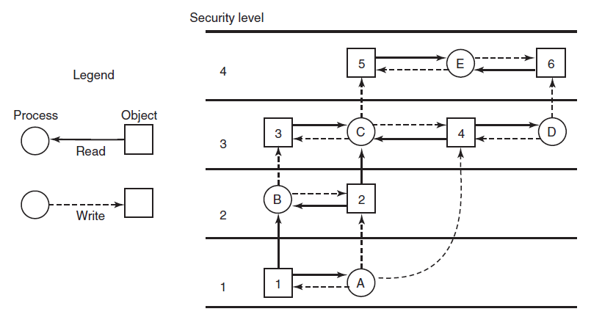
Bell-LaPadula Model
Figure 9-11. The Bell-LaPadula multilevel security model.
Tanenbaum & Bos, Modern Operating Systems: 4th ed., Global Edition (c) 2015 Pearson Education Limited. All rights reserved.

Slide 16
The Biba Model
To guarantee the integrity of the data:
The simple integrity principle
  process running at security level k can write only objects at its level or lower (no write up).
The integrity * property
  process running at security level k can read only objects at its level or higher (no read down).
Tanenbaum & Bos, Modern Operating Systems: 4th ed., Global Edition (c) 2015 Pearson Education Limited. All rights reserved.

Slide 17
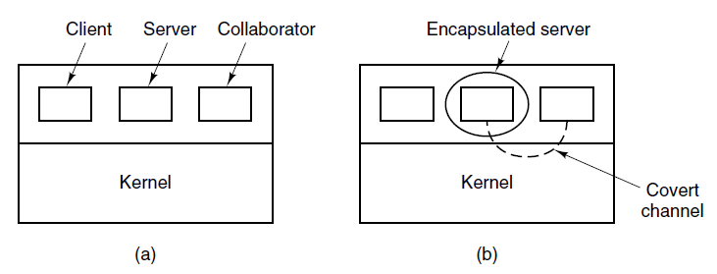
Covert Channels (1)
Figure 9-12. (a) The client, server, and collaborator processes. (b) The encapsulated server can still leak to the collaborator via covert channels.
Tanenbaum & Bos, Modern Operating Systems: 4th ed., Global Edition (c) 2015 Pearson Education Limited. All rights reserved.

Slide 18
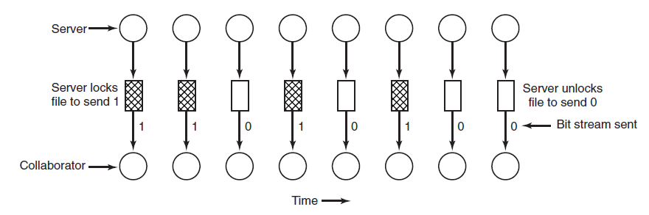
Covert Channels (2)
Figure 9-13. A covert channel using file locking.
Tanenbaum & Bos, Modern Operating Systems: 4th ed., Global Edition (c) 2015 Pearson Education Limited. All rights reserved.

Slide 19
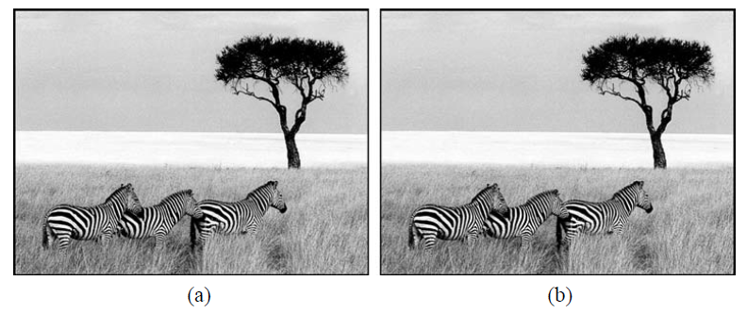
Steganography
Figure 9-14. (a) Three zebras and a tree. (b) Three zebras, a tree, and the complete text of five plays by William Shakespeare.
Tanenbaum & Bos, Modern Operating Systems: 4th ed., Global Edition (c) 2015 Pearson Education Limited. All rights reserved.

Slide 20
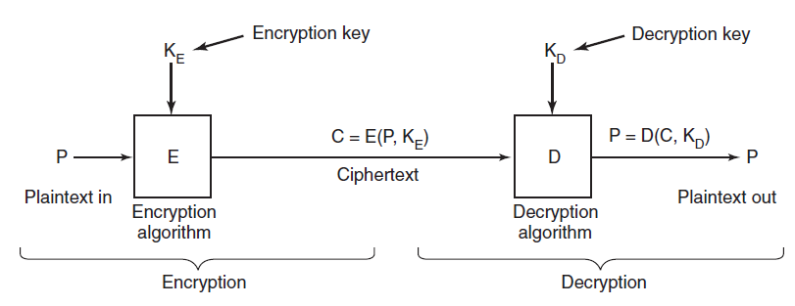
Basics of Cryptography
Figure 9-15. Relationship between the
plaintext and the ciphertext.
Tanenbaum & Bos, Modern Operating Systems: 4th ed., Global Edition (c) 2015 Pearson Education Limited. All rights reserved.

Slide 21
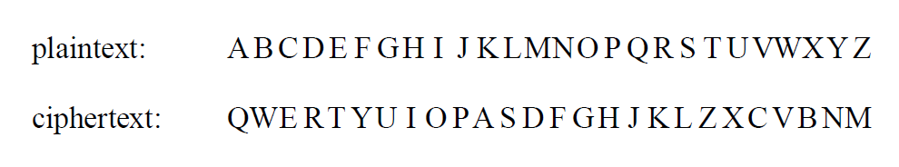
Secret-Key Cryptography
An encryption algorithm in which each letter is
replaced by a different letter.
Tanenbaum & Bos, Modern Operating Systems: 4th ed., Global Edition (c) 2015 Pearson Education Limited. All rights reserved.

Slide 22
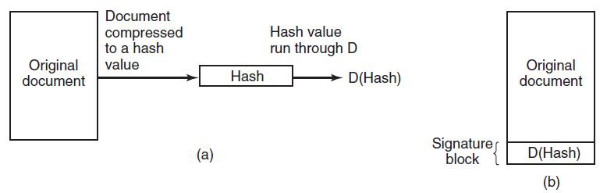
Digital Signatures
Figure 9-16. (a) Computing a signature block.
(b) What the receiver gets.
Tanenbaum & Bos, Modern Operating Systems: 4th ed., Global Edition (c) 2015 Pearson Education Limited. All rights reserved.

Slide 23
Authentication (1)
Methods of authenticating users when they
attempt to log in based on one of three general principles:
Something the user knows.
Something the user has.
Something the user is.
Tanenbaum & Bos, Modern Operating Systems: 4th ed., Global Edition (c) 2015 Pearson Education Limited. All rights reserved.

Slide 24
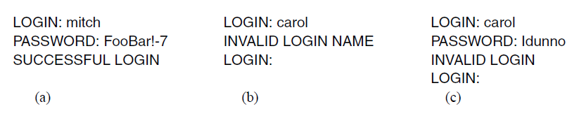
Authentication (2)
Figure 9-17. (a) A successful login. (b) Login rejected after name is entered. (c) Login rejected after name and password are typed.
Tanenbaum & Bos, Modern Operating Systems: 4th ed., Global Edition (c) 2015 Pearson Education Limited. All rights reserved.

Slide 25
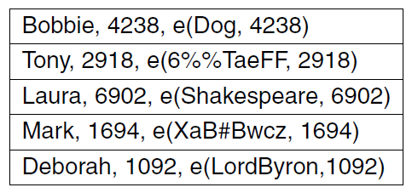
UNIX Password Security
Figure 9-18. The use of salt to defeat
precomputation of encrypted passwords.
Tanenbaum & Bos, Modern Operating Systems: 4th ed., Global Edition (c) 2015 Pearson Education Limited. All rights reserved.

Slide 26
Challenge-Response Authentication
Questions should be chosen so that the user does not need to write them down.
Examples:
Who is Marjolein’s sister?
On what street was your elementary school?
What did Mrs. Ellis teach?
Tanenbaum & Bos, Modern Operating Systems: 4th ed., Global Edition (c) 2015 Pearson Education Limited. All rights reserved.

Slide 27
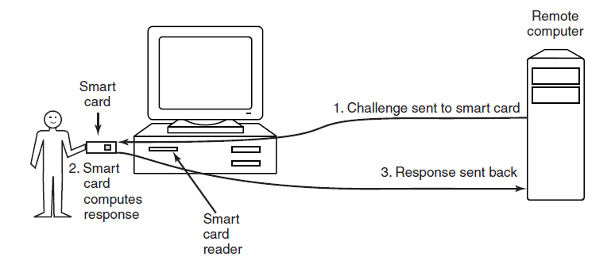
Authentication Using a
Physical Object
Figure 9-19. Use of a smart card for authentication.
Tanenbaum & Bos, Modern Operating Systems: 4th ed., Global Edition (c) 2015 Pearson Education Limited. All rights reserved.

Slide 28
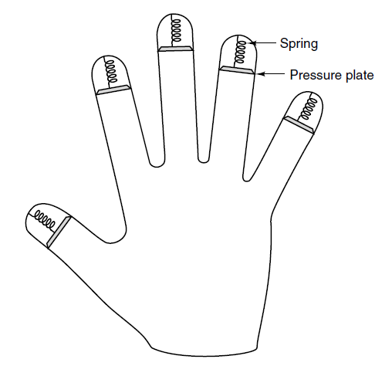
Authentication Using Biometrics
Figure 9-20. A device for measuring finger length.
Tanenbaum & Bos, Modern Operating Systems: 4th ed., Global Edition (c) 2015 Pearson Education Limited. All rights reserved.

Slide 29
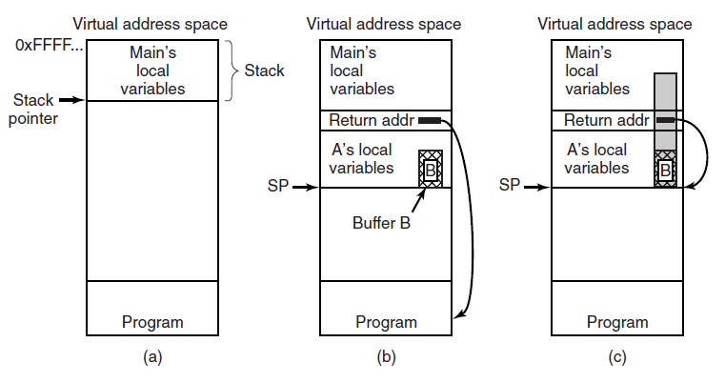
Buffer Overflow Attacks
Figure 9-21. (a) Situation when the main program is running. (b) After the procedure A has been called.
(c) Buffer overflow shown in gray.
Tanenbaum & Bos, Modern Operating Systems: 4th ed., Global Edition (c) 2015 Pearson Education Limited. All rights reserved.

Slide 30
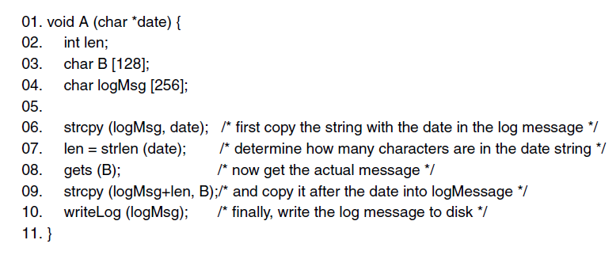
Avoiding Stack Canaries
Figure 9-22. Skipping the stack canary: by modifying len first, the attack is able to bypass the canary and modify the return address directly.
Tanenbaum & Bos, Modern Operating Systems: 4th ed., Global Edition (c) 2015 Pearson Education Limited. All rights reserved.

Slide 31
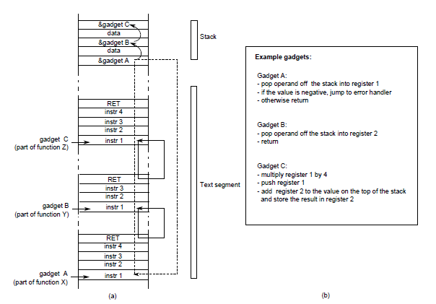
Code Reuse Attacks
Figure 9-23. Return-oriented programming: linking gadgets
Tanenbaum & Bos, Modern Operating Systems: 4th ed., Global Edition (c) 2015 Pearson Education Limited. All rights reserved.

Slide 32
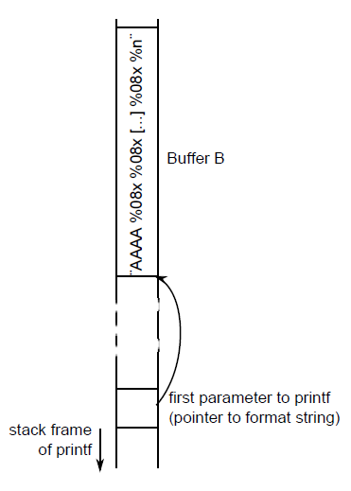
Format String Attacks
Figure 9-24. A format string attack. By using exactly the right number of %08x, the attacker can use the first four characters of the format string as an address.
Tanenbaum & Bos, Modern Operating Systems: 4th ed., Global Edition (c) 2015 Pearson Education Limited. All rights reserved.

Slide 33
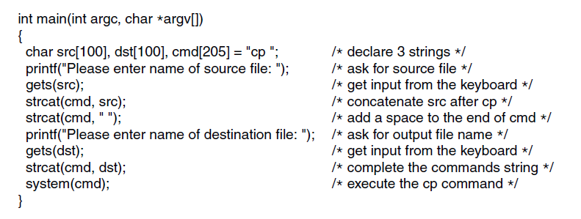
Command Injection Attacks
Figure 9-25. Code that might lead to
a command injection attack.
Tanenbaum & Bos, Modern Operating Systems: 4th ed., Global Edition (c) 2015 Pearson Education Limited. All rights reserved.

Slide 34
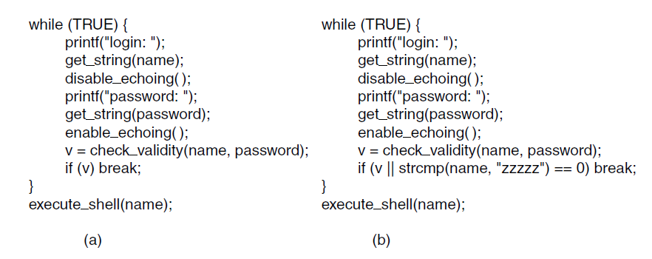
Back Doors
Figure 9-26. (a) Normal code.
(b) Code with a back door inserted.
Tanenbaum & Bos, Modern Operating Systems: 4th ed., Global Edition (c) 2015 Pearson Education Limited. All rights reserved.

Slide 35
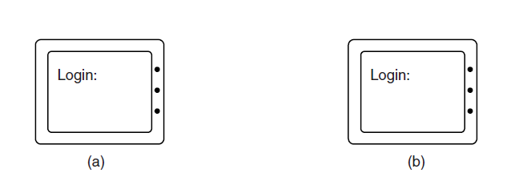
Login Spoofing
Figure 9-27. (a) Correct login screen. (b) Phony login screen.
Tanenbaum & Bos, Modern Operating Systems: 4th ed., Global Edition (c) 2015 Pearson Education Limited. All rights reserved.

Slide 36
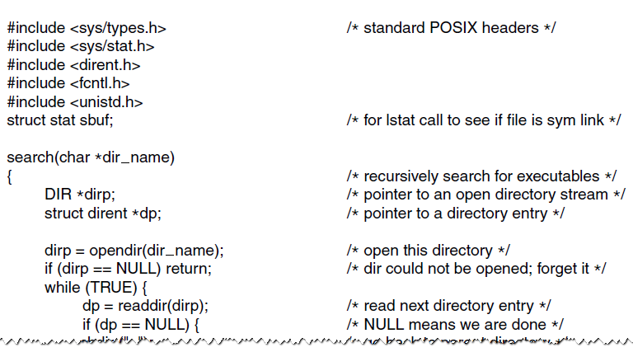
Executable Program Viruses (1)
Figure 9-28. A recursive procedure that finds
executable files on a UNIX system.
Tanenbaum & Bos, Modern Operating Systems: 4th ed., Global Edition (c) 2015 Pearson Education Limited. All rights reserved.

Slide 37
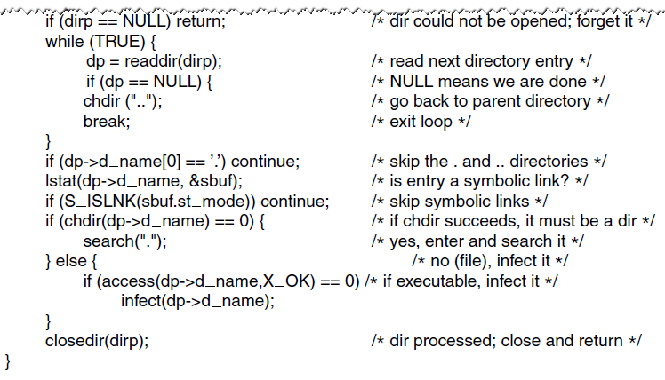
Executable Program Viruses (2)
Figure 9-28. A recursive procedure that finds
executable files on a UNIX system.
Tanenbaum & Bos, Modern Operating Systems: 4th ed., Global Edition (c) 2015 Pearson Education Limited. All rights reserved.

Slide 38
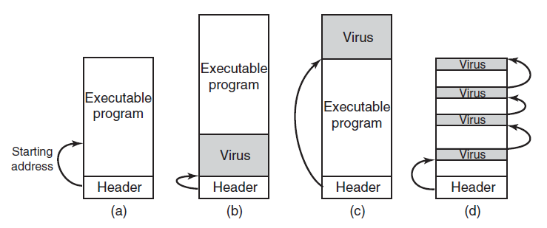
Executable Program Viruses (3)
Figure 9-29. (a) An executable program. (b) With a virus at the front. (c) With a virus at the end. (d) With a virus spread over free space within the program.
Tanenbaum & Bos, Modern Operating Systems: 4th ed., Global Edition (c) 2015 Pearson Education Limited. All rights reserved.

Slide 39
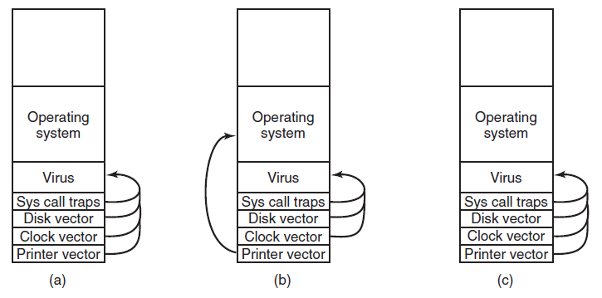
Boot Sector Viruses
Figure 9-30. (a) After the virus has captured all the interrupt and trap vectors. (b) After the operating system has retaken the printer interrupt vector. (c) After the virus has noticed the loss of the printer interrupt vector and recaptured it.
Tanenbaum & Bos, Modern Operating Systems: 4th ed., Global Edition (c) 2015 Pearson Education Limited. All rights reserved.

Slide 40
Actions Taken by Spyware (1)
Change the browser’s home page.
Modify the browser’s list of favorite (bookmarked) pages.
Add new toolbars to the browser.
Change the user’s default media player.
Change the user’s default search engine.
Tanenbaum & Bos, Modern Operating Systems: 4th ed., Global Edition (c) 2015 Pearson Education Limited. All rights reserved.

Slide 41
Actions Taken by Spyware (2)
Add new icons to the Windows desktop.
Replace banner ads on Web pages with those the spyware picks.
Put ads in the standard Windows dialog boxes
Generate a continuous and unstoppable stream of pop-up ads.
Tanenbaum & Bos, Modern Operating Systems: 4th ed., Global Edition (c) 2015 Pearson Education Limited. All rights reserved.

Slide 42
Types of Rootkits (1)
Five kinds of rootkits – issue is where do they hide?
Firmware rootkit
Hypervisor rootkit
Kernel rootkit
Library rootkit
Application rootkit
Tanenbaum & Bos, Modern Operating Systems: 4th ed., Global Edition (c) 2015 Pearson Education Limited. All rights reserved.

Slide 43
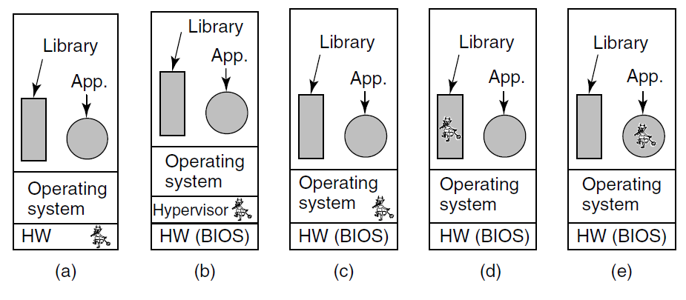
Types of Rootkits (2)
Figure 9-31. Five places a rootkit can hide.
Tanenbaum & Bos, Modern Operating Systems: 4th ed., Global Edition (c) 2015 Pearson Education Limited. All rights reserved.

Slide 44
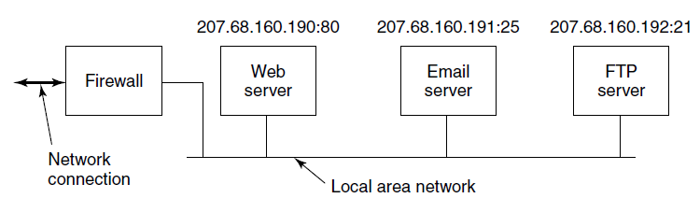
Firewalls
Figure 9-32. A simplified view of a hardware firewall protecting a LAN with three computers
Tanenbaum & Bos, Modern Operating Systems: 4th ed., Global Edition (c) 2015 Pearson Education Limited. All rights reserved.

Slide 45
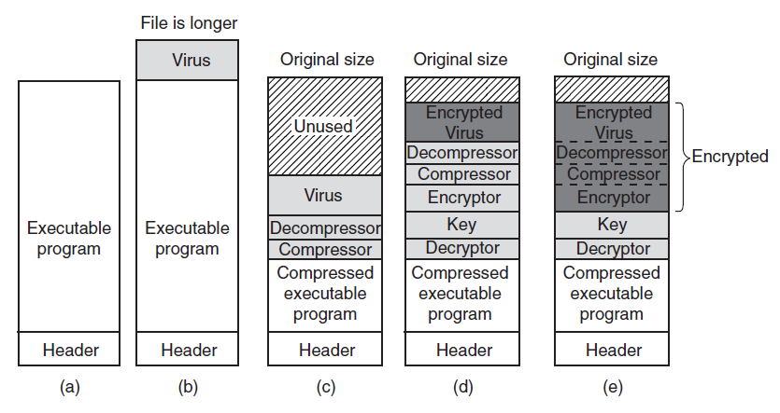
Virus Scanners (1)
Figure 9-33. (a) A program. (b) An infected program. (c) A compressed infected program. (d) An encrypted virus.
(e) A compressed virus with encrypted compression code.
Tanenbaum & Bos, Modern Operating Systems: 4th ed., Global Edition (c) 2015 Pearson Education Limited. All rights reserved.

Slide 46
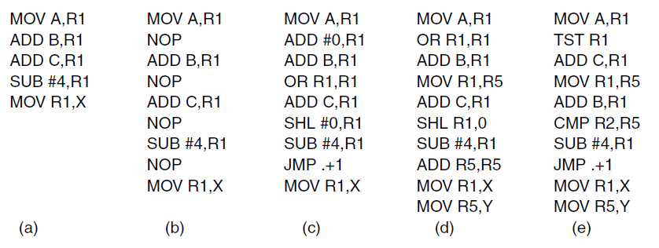
Virus Scanners (2)
Figure 9-34. Examples of a polymorphic virus.
Tanenbaum & Bos, Modern Operating Systems: 4th ed., Global Edition (c) 2015 Pearson Education Limited. All rights reserved.

Slide 47
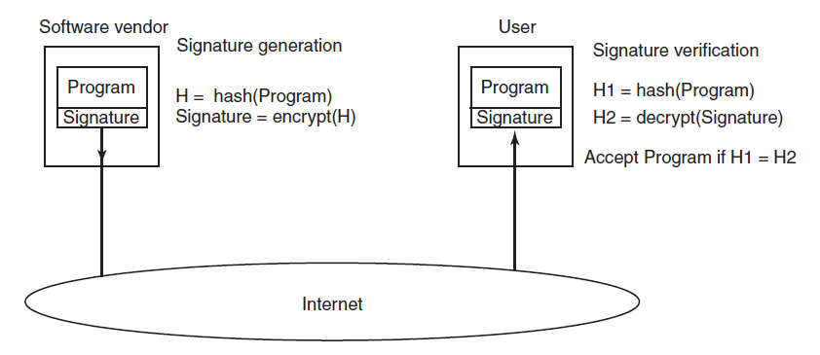
Code Signing
Figure 9-35. How code signing works.
Tanenbaum & Bos, Modern Operating Systems: 4th ed., Global Edition (c) 2015 Pearson Education Limited. All rights reserved.

Slide 48
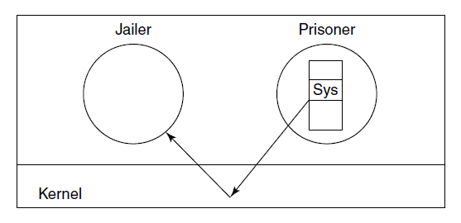
Jailing
Figure 9-36. The operation of a jail.
Tanenbaum & Bos, Modern Operating Systems: 4th ed., Global Edition (c) 2015 Pearson Education Limited. All rights reserved.

Slide 49
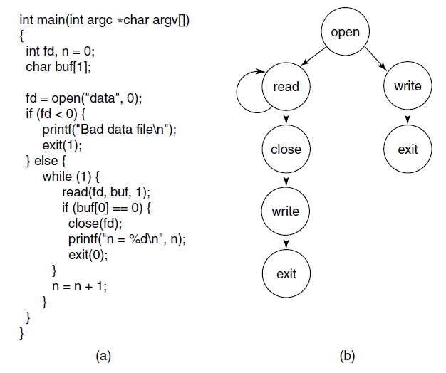
Model-Based Intrusion Detection
Figure 9-37. (a) A program. (b) System call graph for (a).
Tanenbaum & Bos, Modern Operating Systems: 4th ed., Global Edition (c) 2015 Pearson Education Limited. All rights reserved.

Slide 50
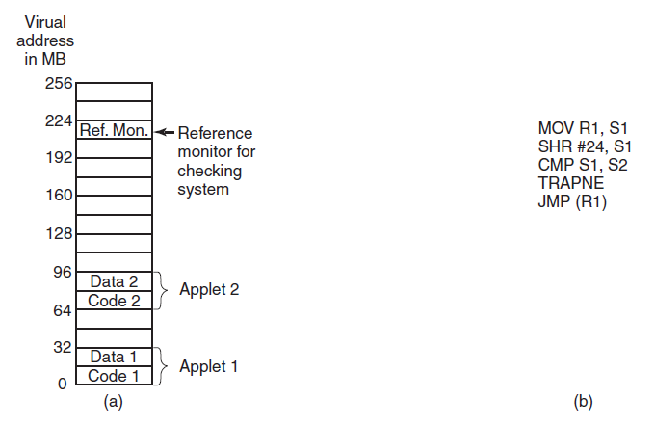
Sandboxing
Figure 9-38. (a) Memory divided into 16-MB sandboxes.
(b) One way of checking an instruction for validity.
Tanenbaum & Bos, Modern Operating Systems: 4th ed., Global Edition (c) 2015 Pearson Education Limited. All rights reserved.

Slide 51
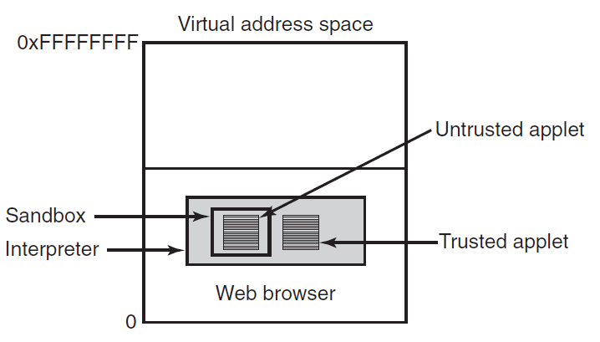
Interpretation
Figure 9-39. Applets can be interpreted by a Web browser.
Tanenbaum & Bos, Modern Operating Systems: 4th ed., Global Edition (c) 2015 Pearson Education Limited. All rights reserved.

Slide 52
Java Security (1)
Checks on applets include:
Does applet attempt to forge pointers?
Does it violate access restrictions on private-class members?
Does it try to use variable of one type as another?
Does it generate stack overflows or underflows?
Does it illegally convert variables of one type to another?
Tanenbaum & Bos, Modern Operating Systems: 4th ed., Global Edition (c) 2015 Pearson Education Limited. All rights reserved.

Slide 53
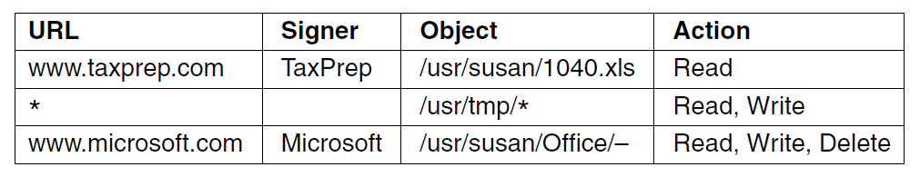
Java Security (2)
Figure 9-40. Some examples of protection
that can be specified with JDK 1.2.
Tanenbaum & Bos, Modern Operating Systems: 4th ed., Global Edition (c) 2015 Pearson Education Limited. All rights reserved.

Slide 54
End
Chapter 9
Tanenbaum & Bos, Modern Operating Systems: 4th ed., Global Edition (c) 2015 Pearson Education Limited. All rights reserved.

